Slide 1
Project Week 5

Slide 2
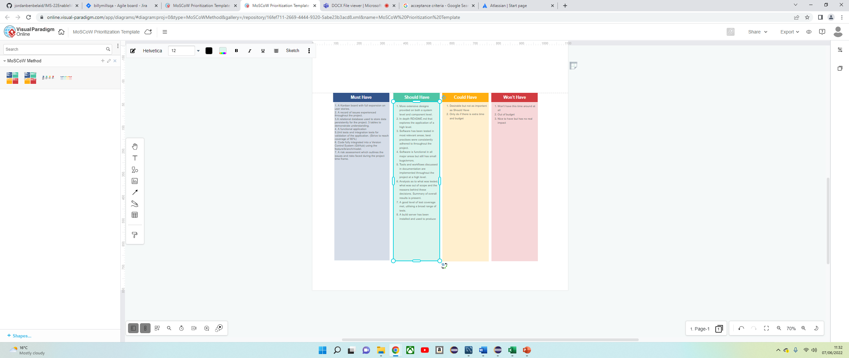
Initial creation of MoSCoW Prioritisation model

Slide 3
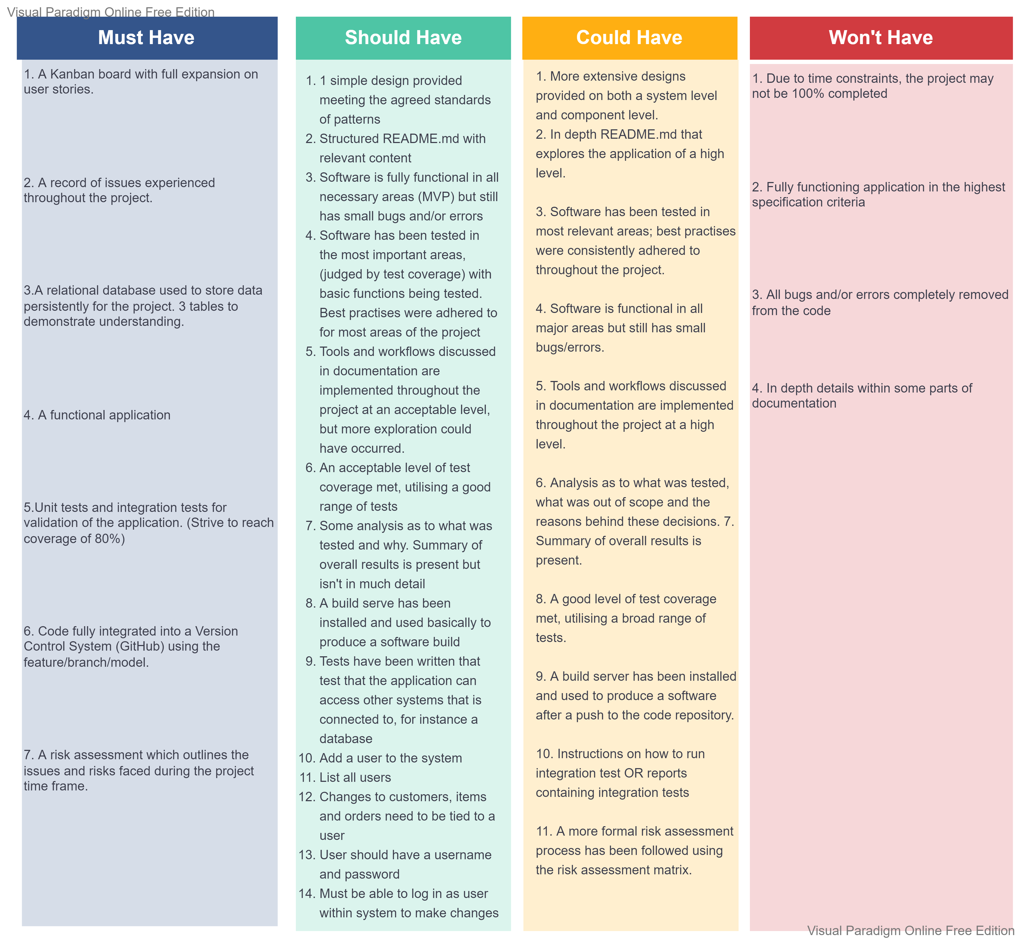
Completed MoSCoW Prioritisation

Slide 4
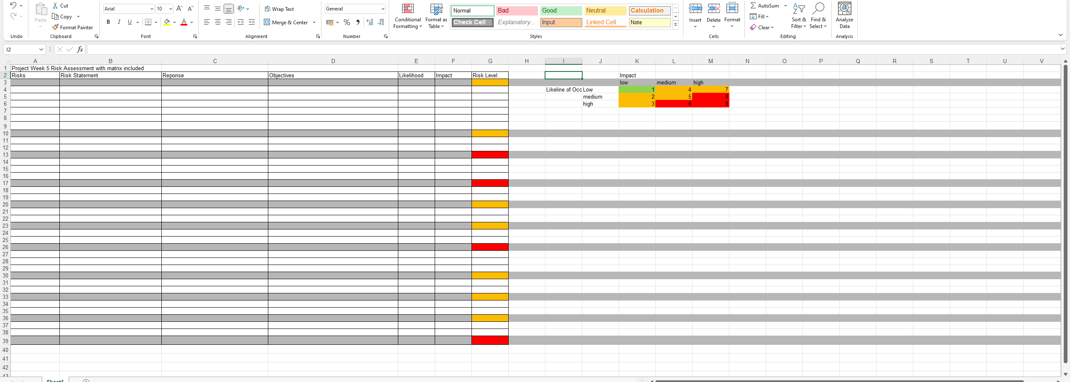
Initial creation of risk assessment including matrix

Slide 5
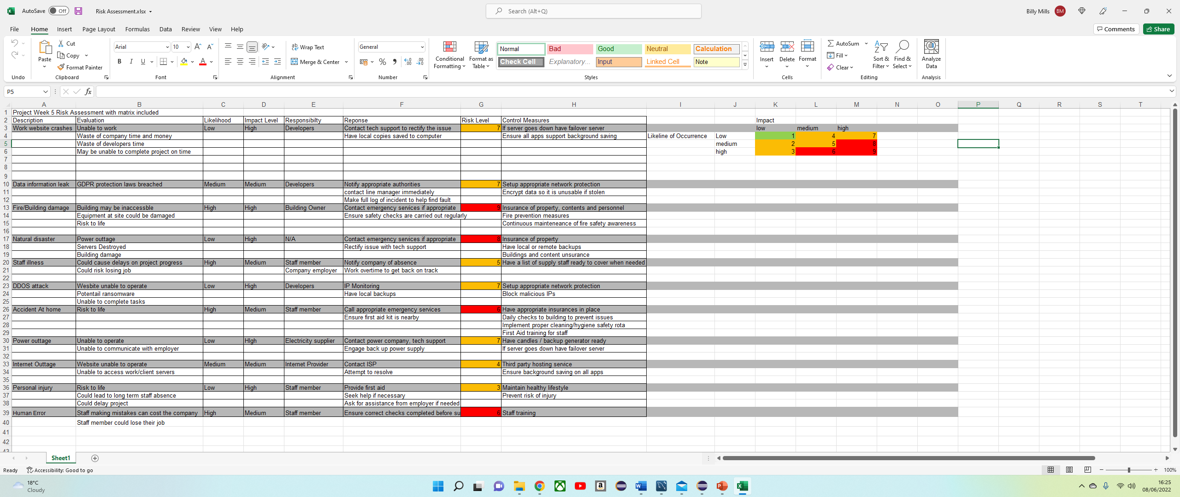
Completed model of risk assessment including matrix

Slide 6
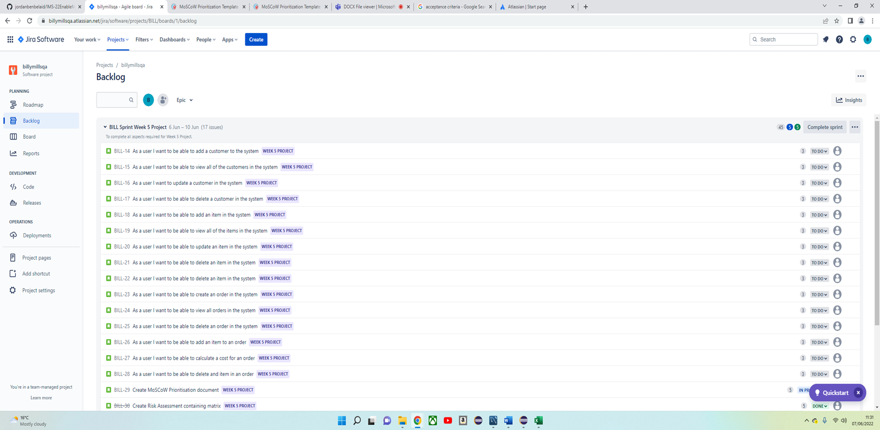
Created user stories within an epic on MySQL (including acceptance criteria & story point estimates)

Slide 7
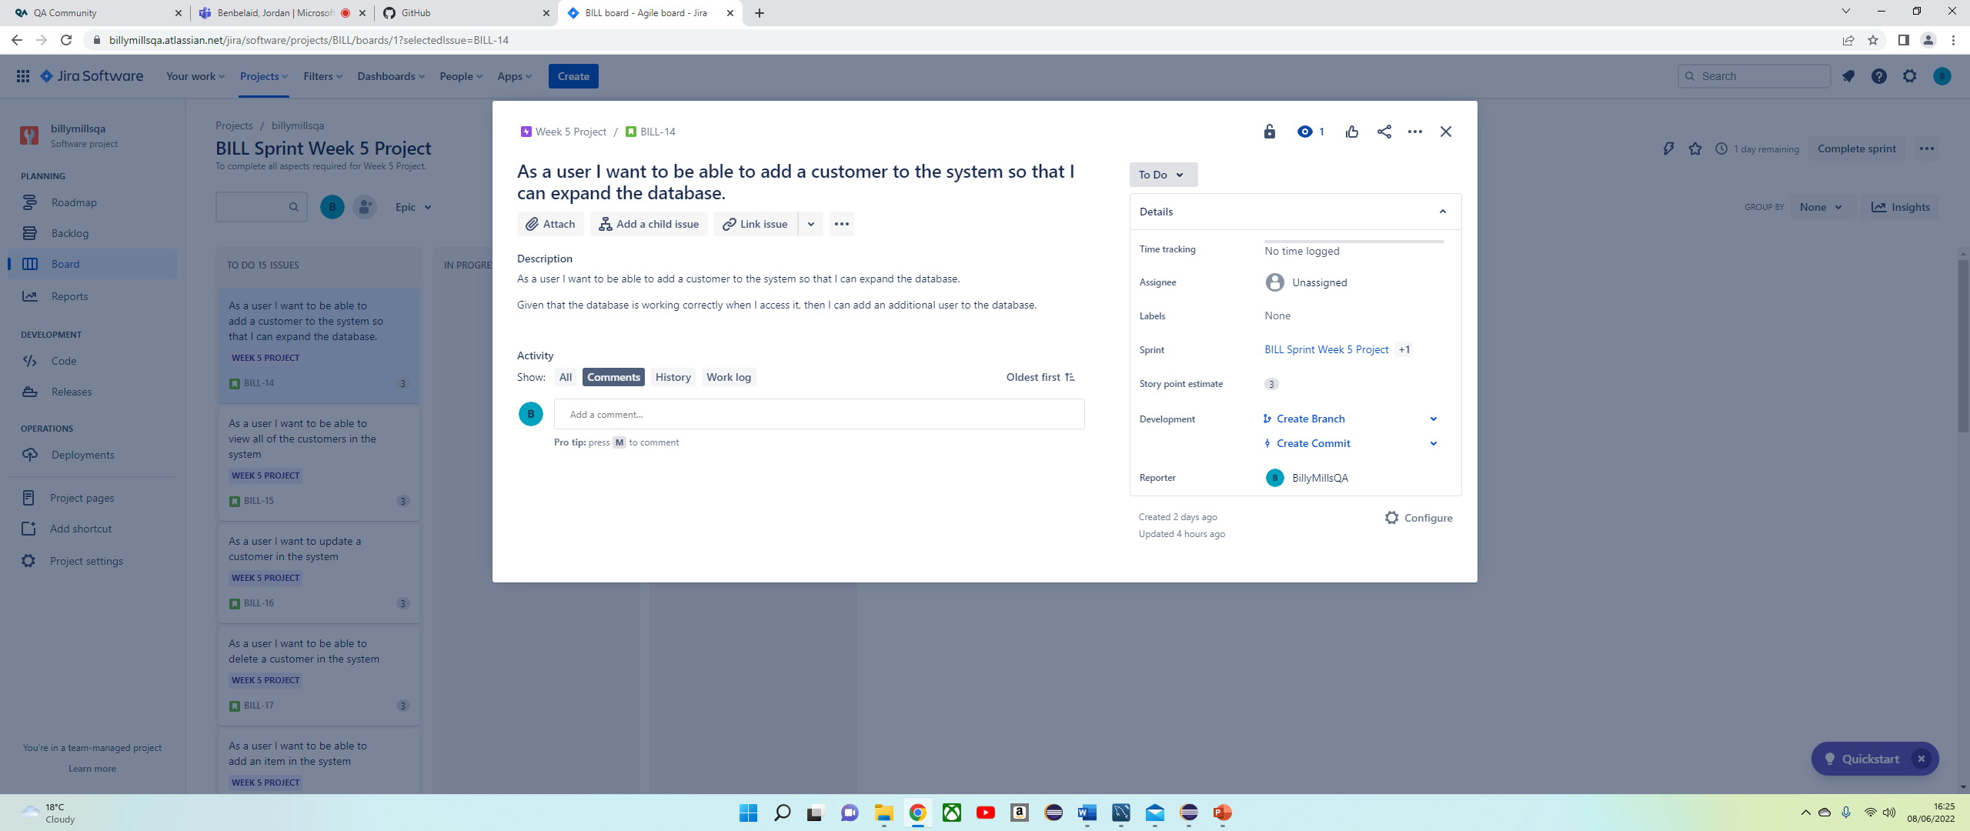
Example of user story

Slide 8
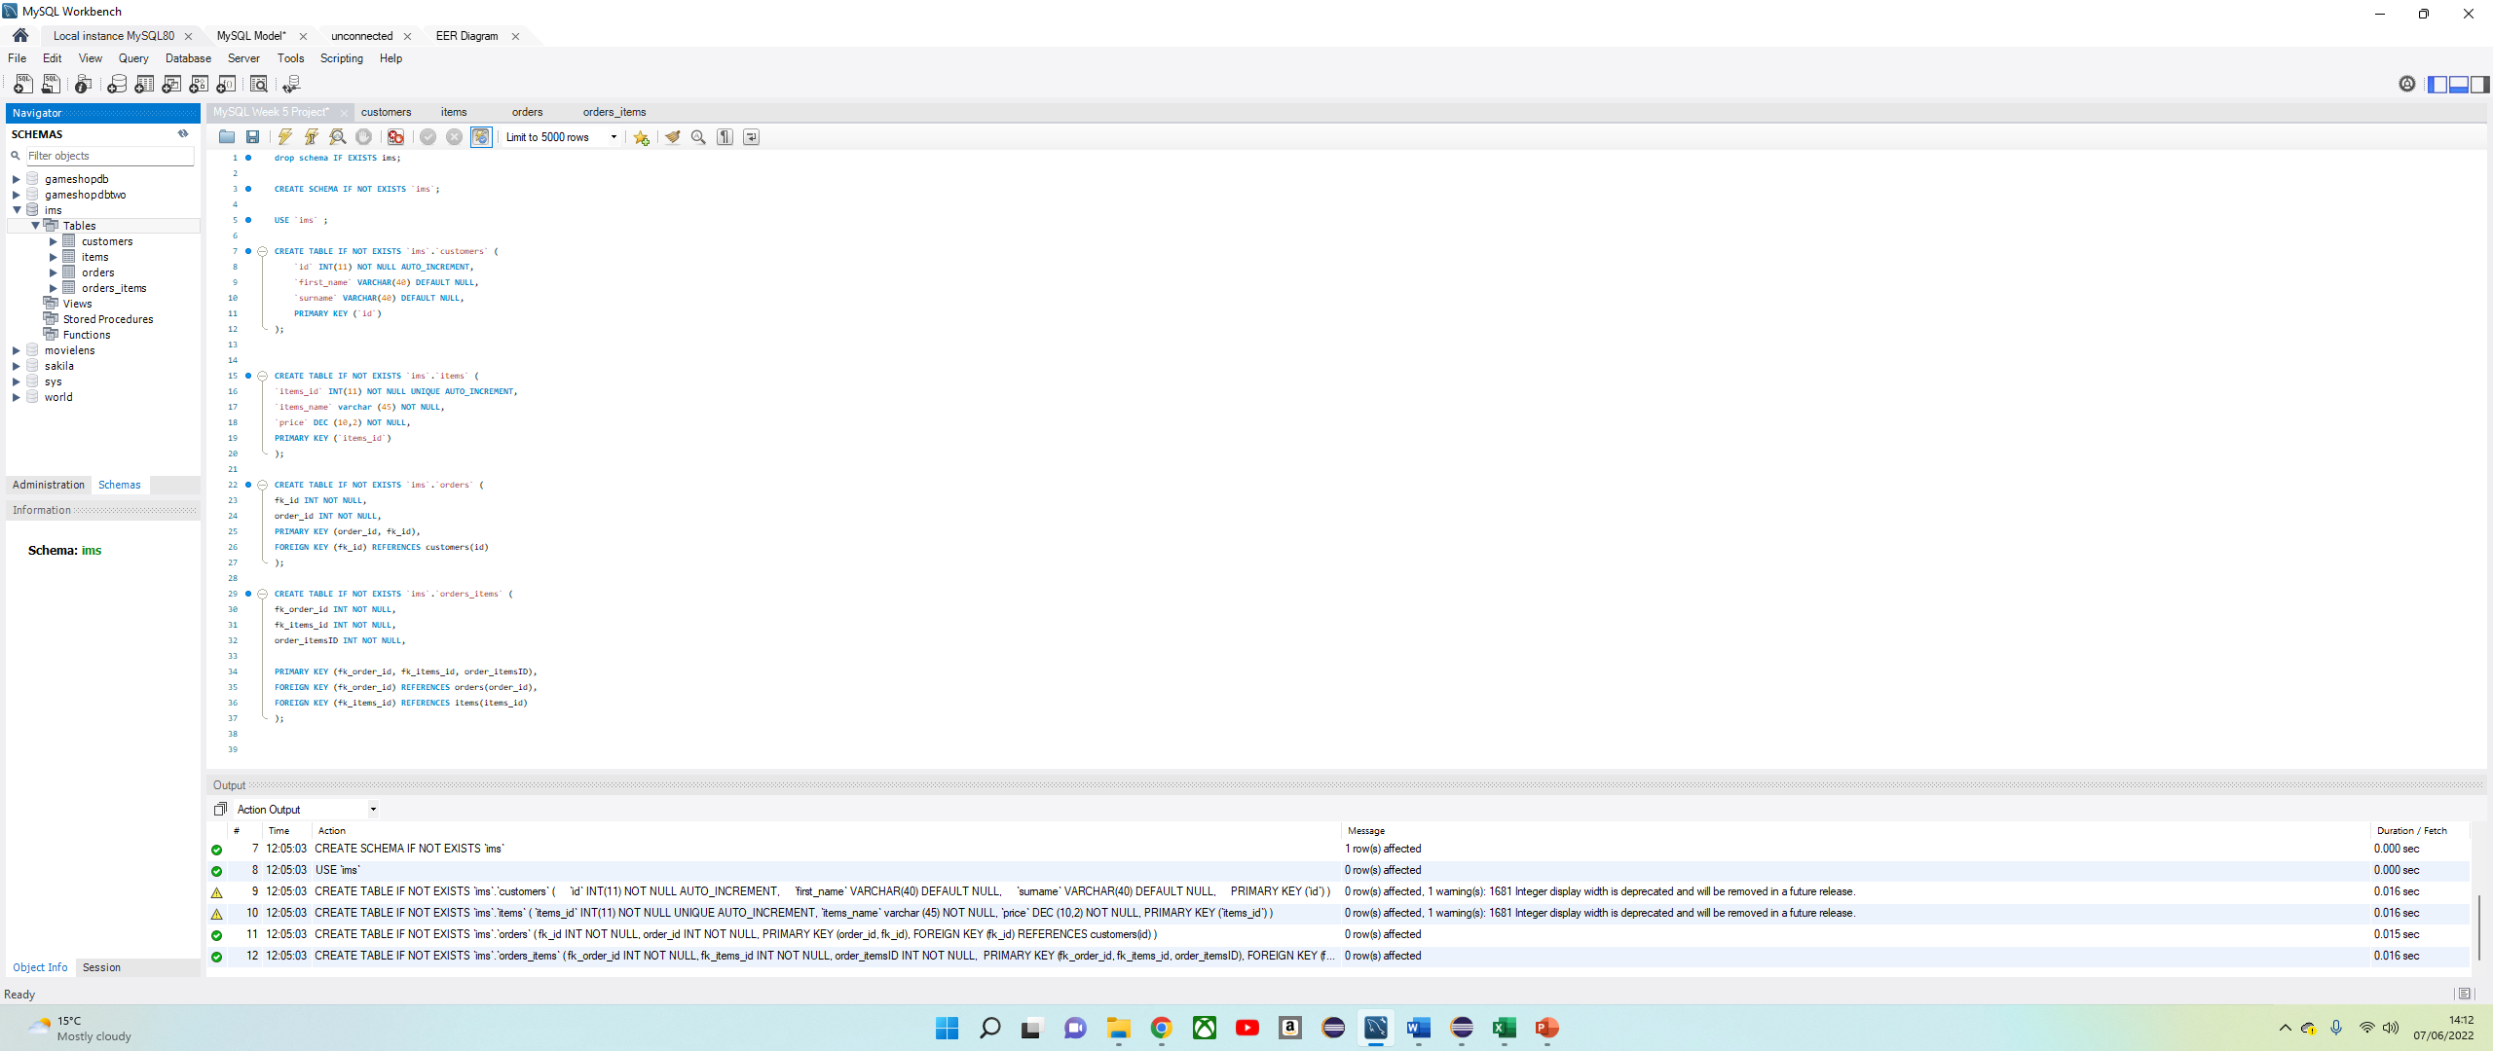
Created items, orders and orders_items tables in MySQL

Slide 9
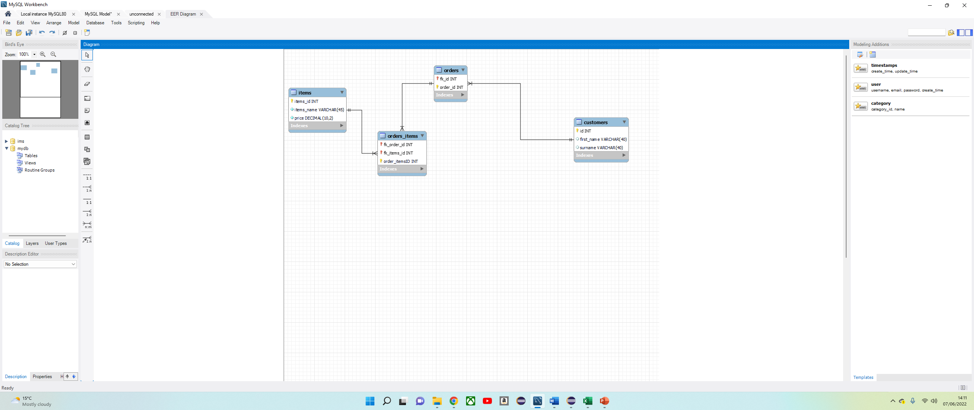
Initial ERD in relation to the MySQL tables

Slide 10
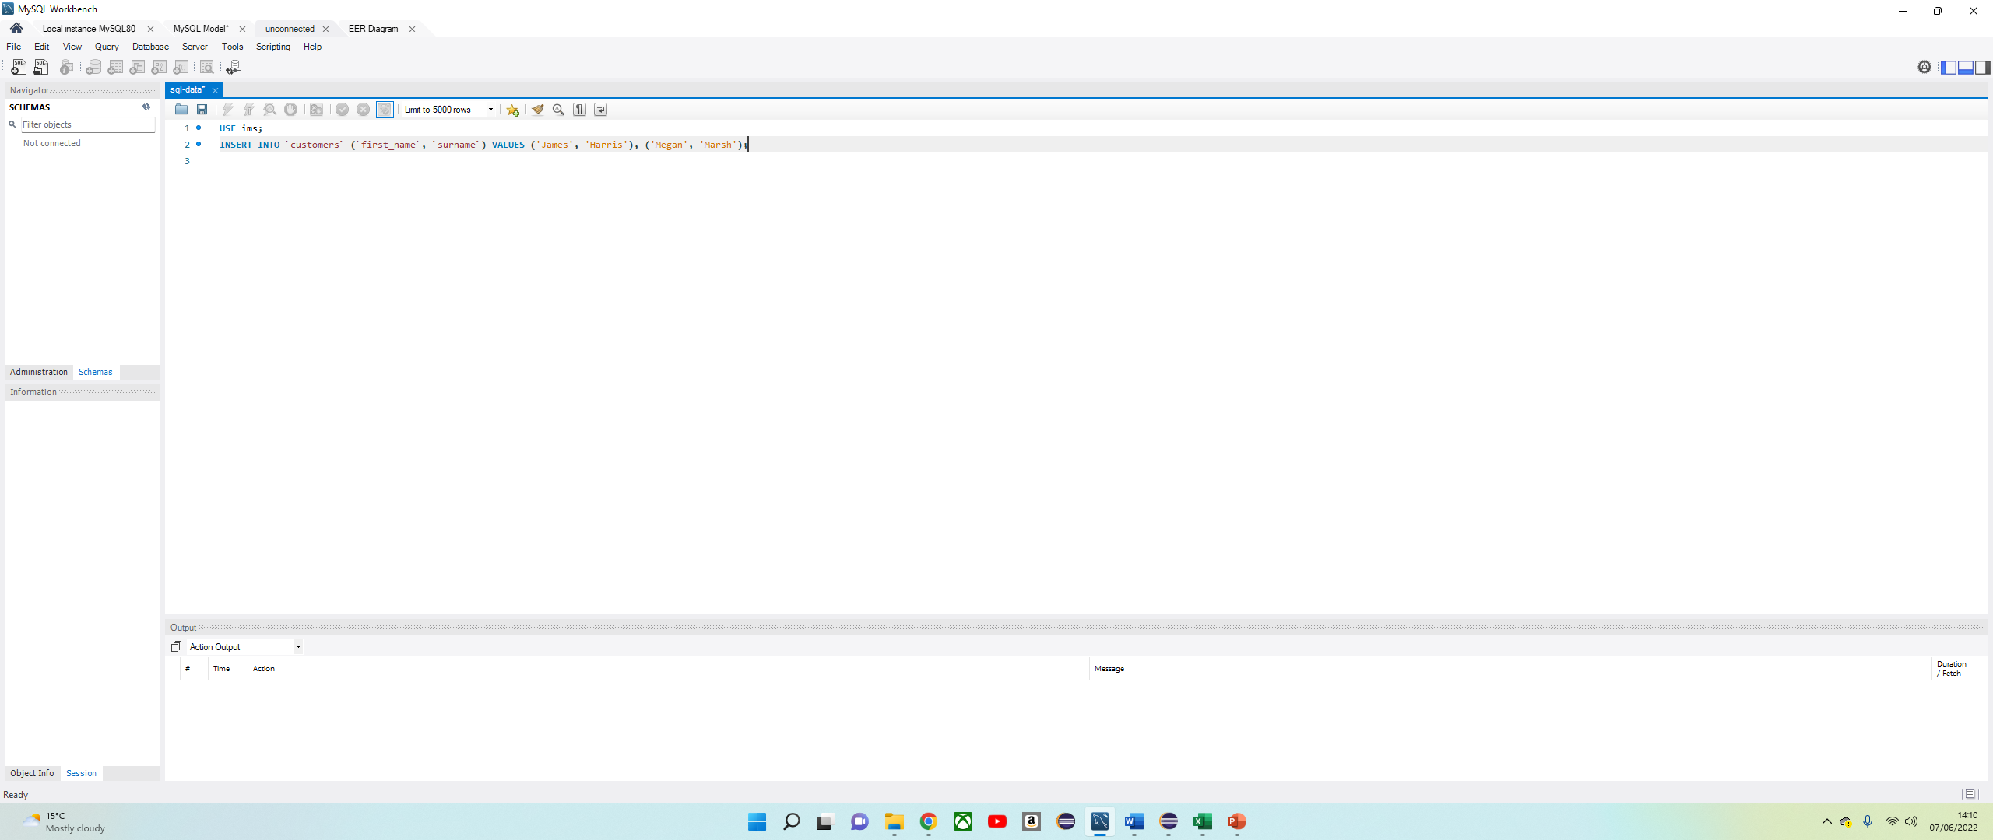
Assigning values to individual inputs for all tables

Slide 11
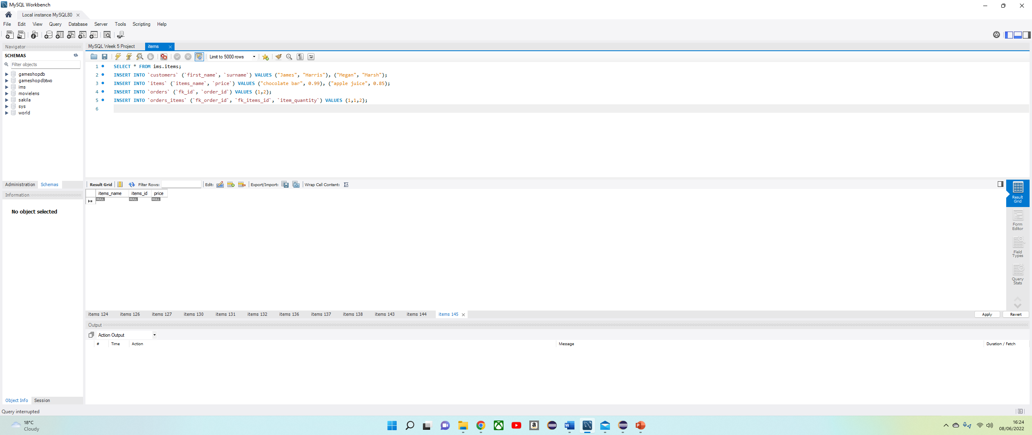
Completed model of assigned values in MySQL

Slide 12
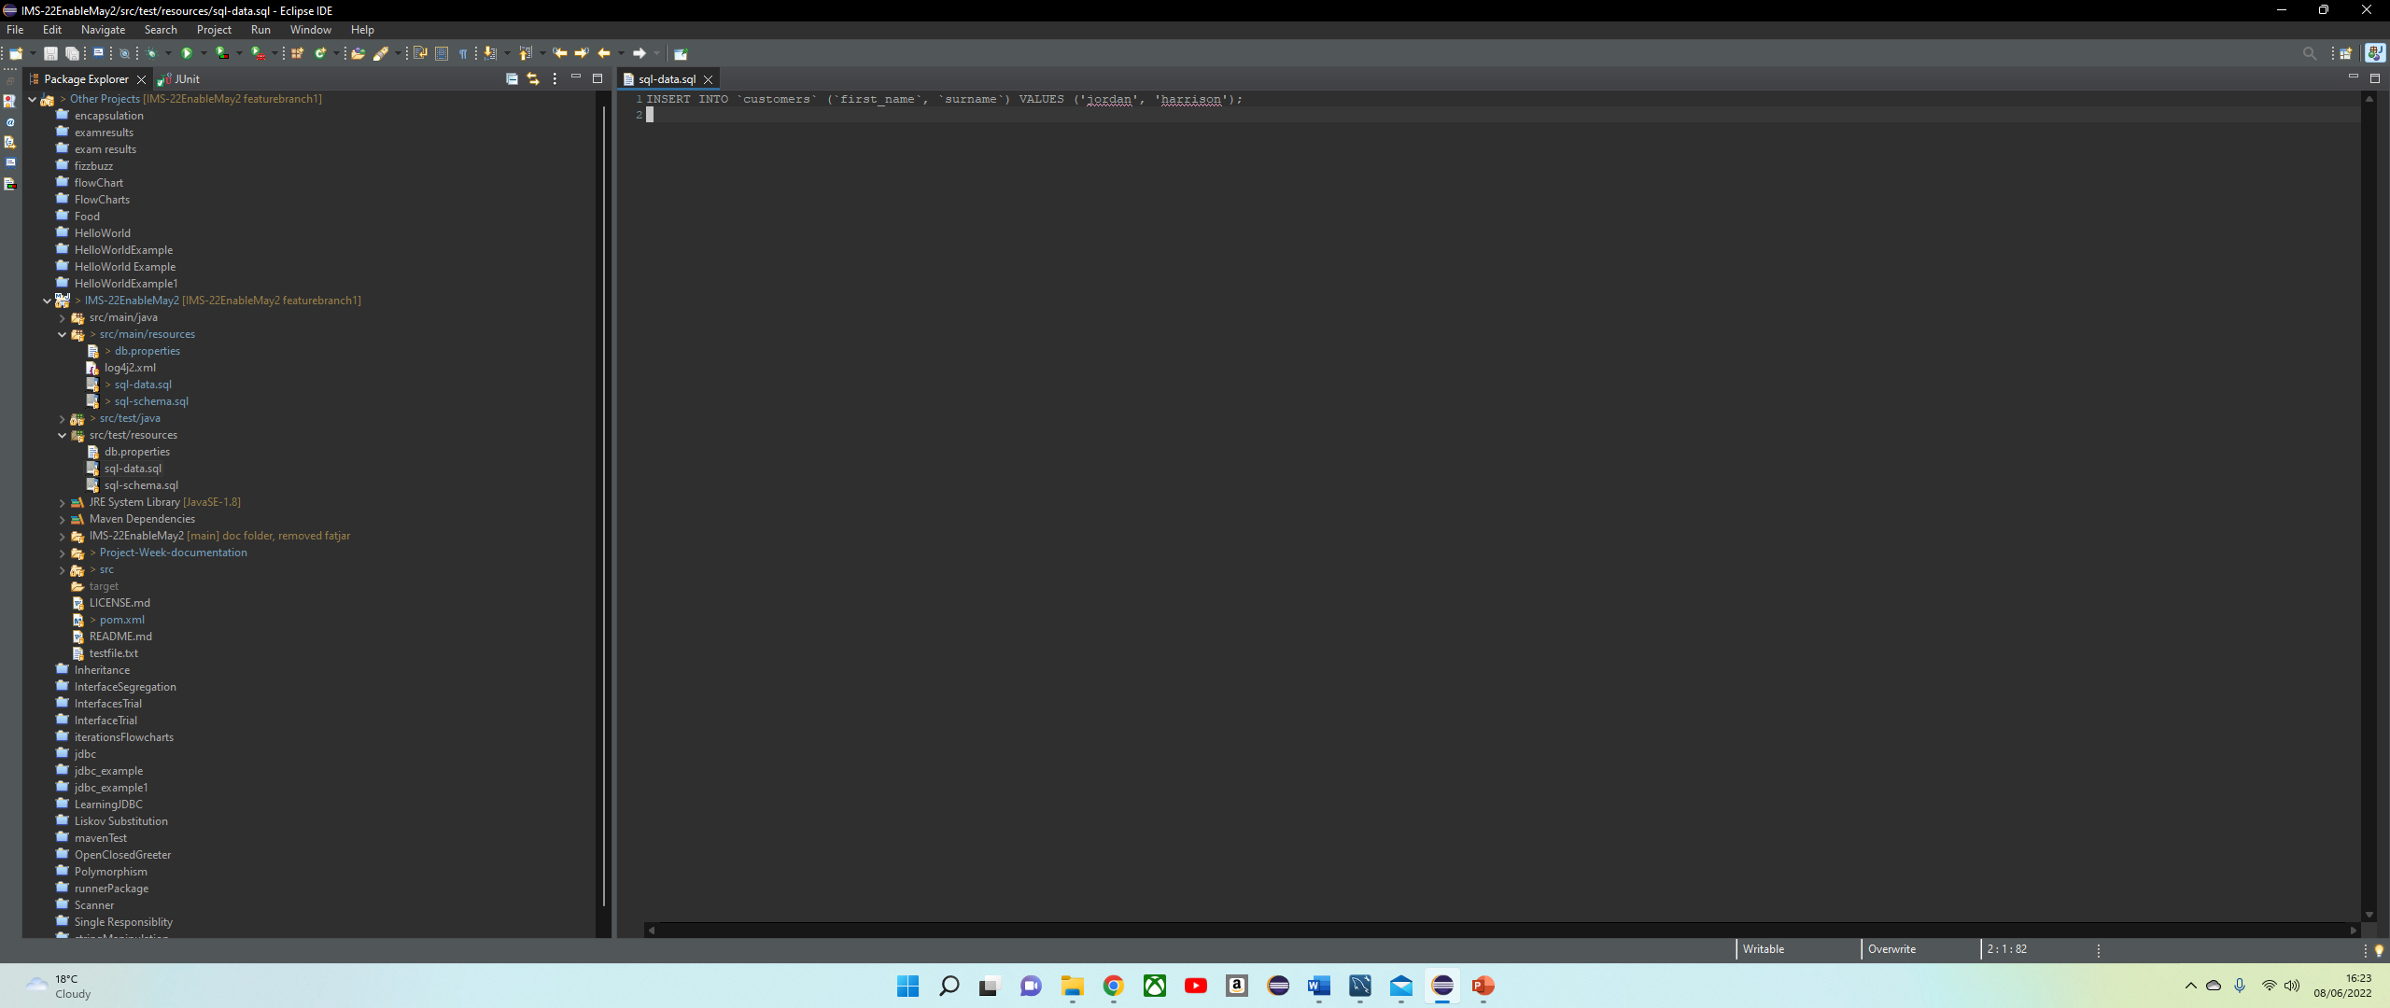
Inserting MySQL values into Eclipse

Slide 13
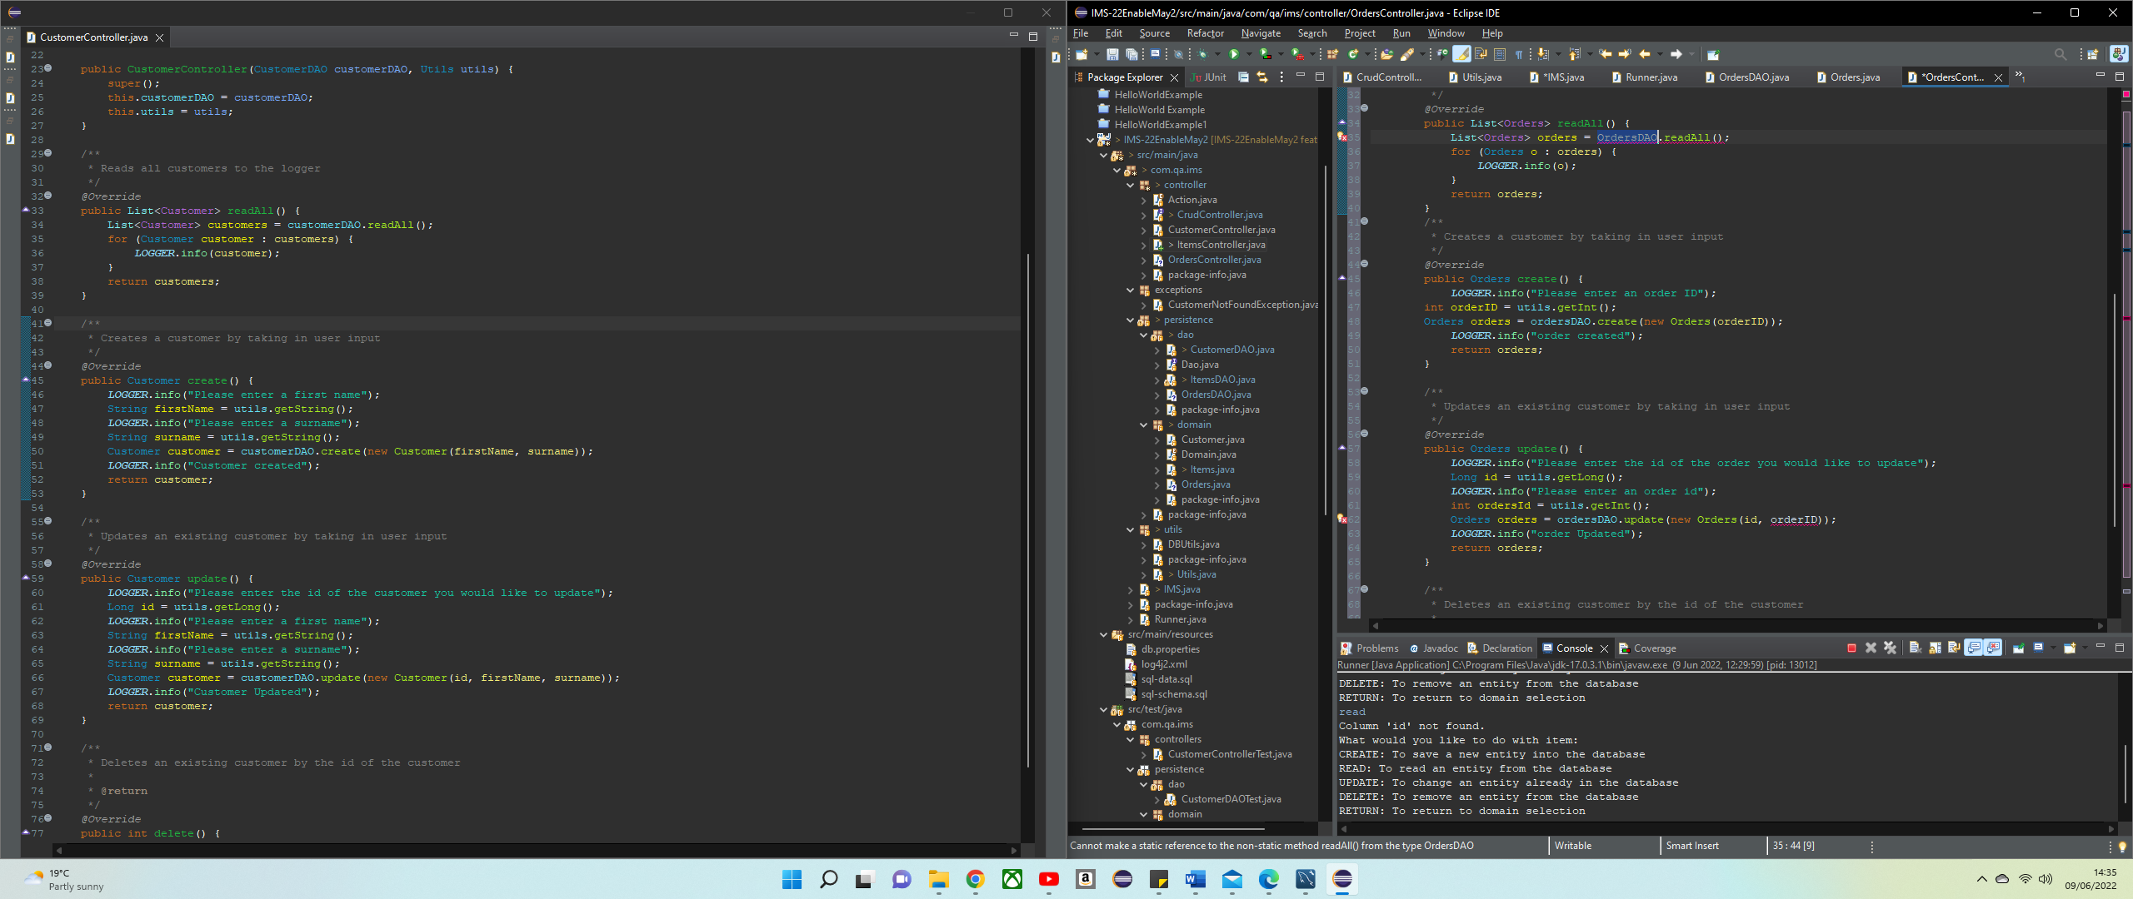
Creating class, DAO’s and Controllers for all classes within Eclipse

Slide 14
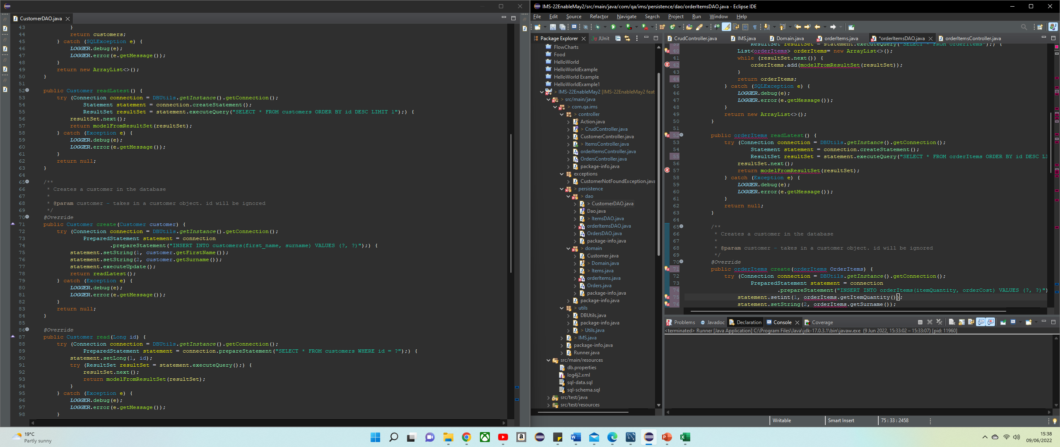
Continued

Slide 15
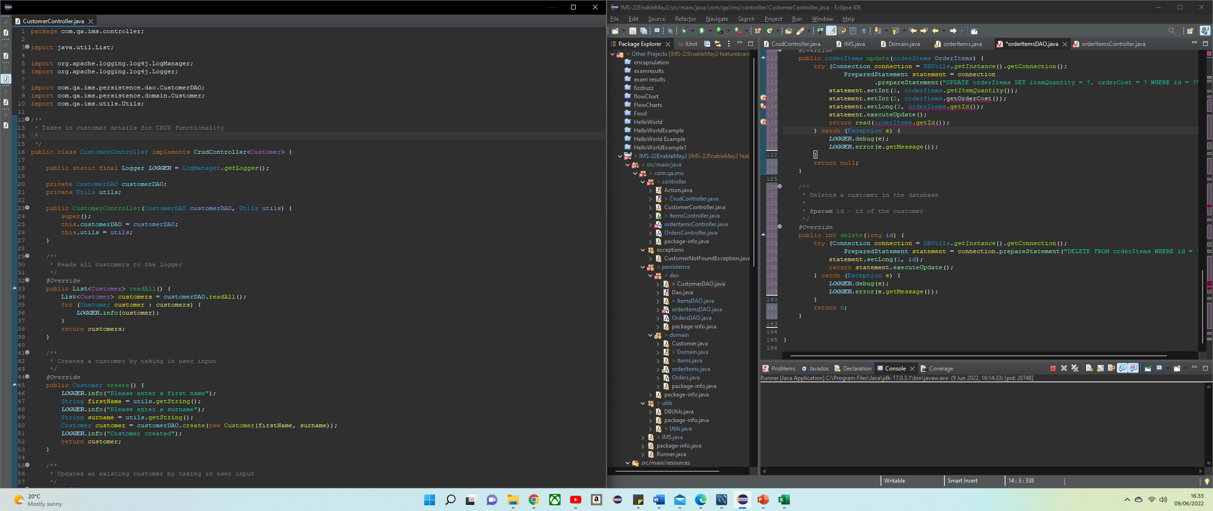
Continued

Slide 16
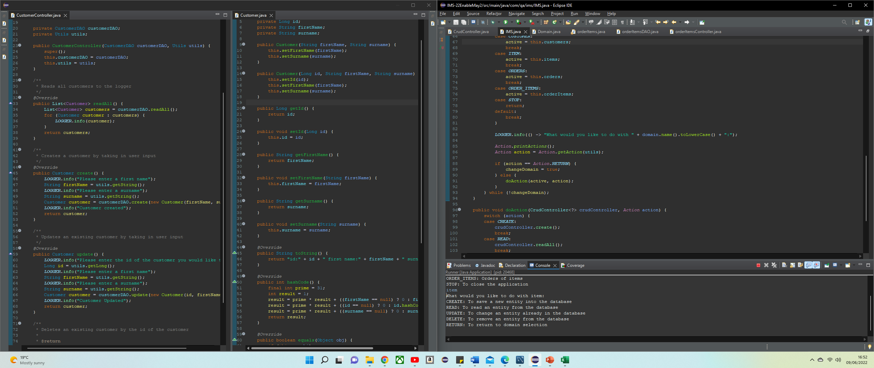
Showing the working database in an example

Slide 17
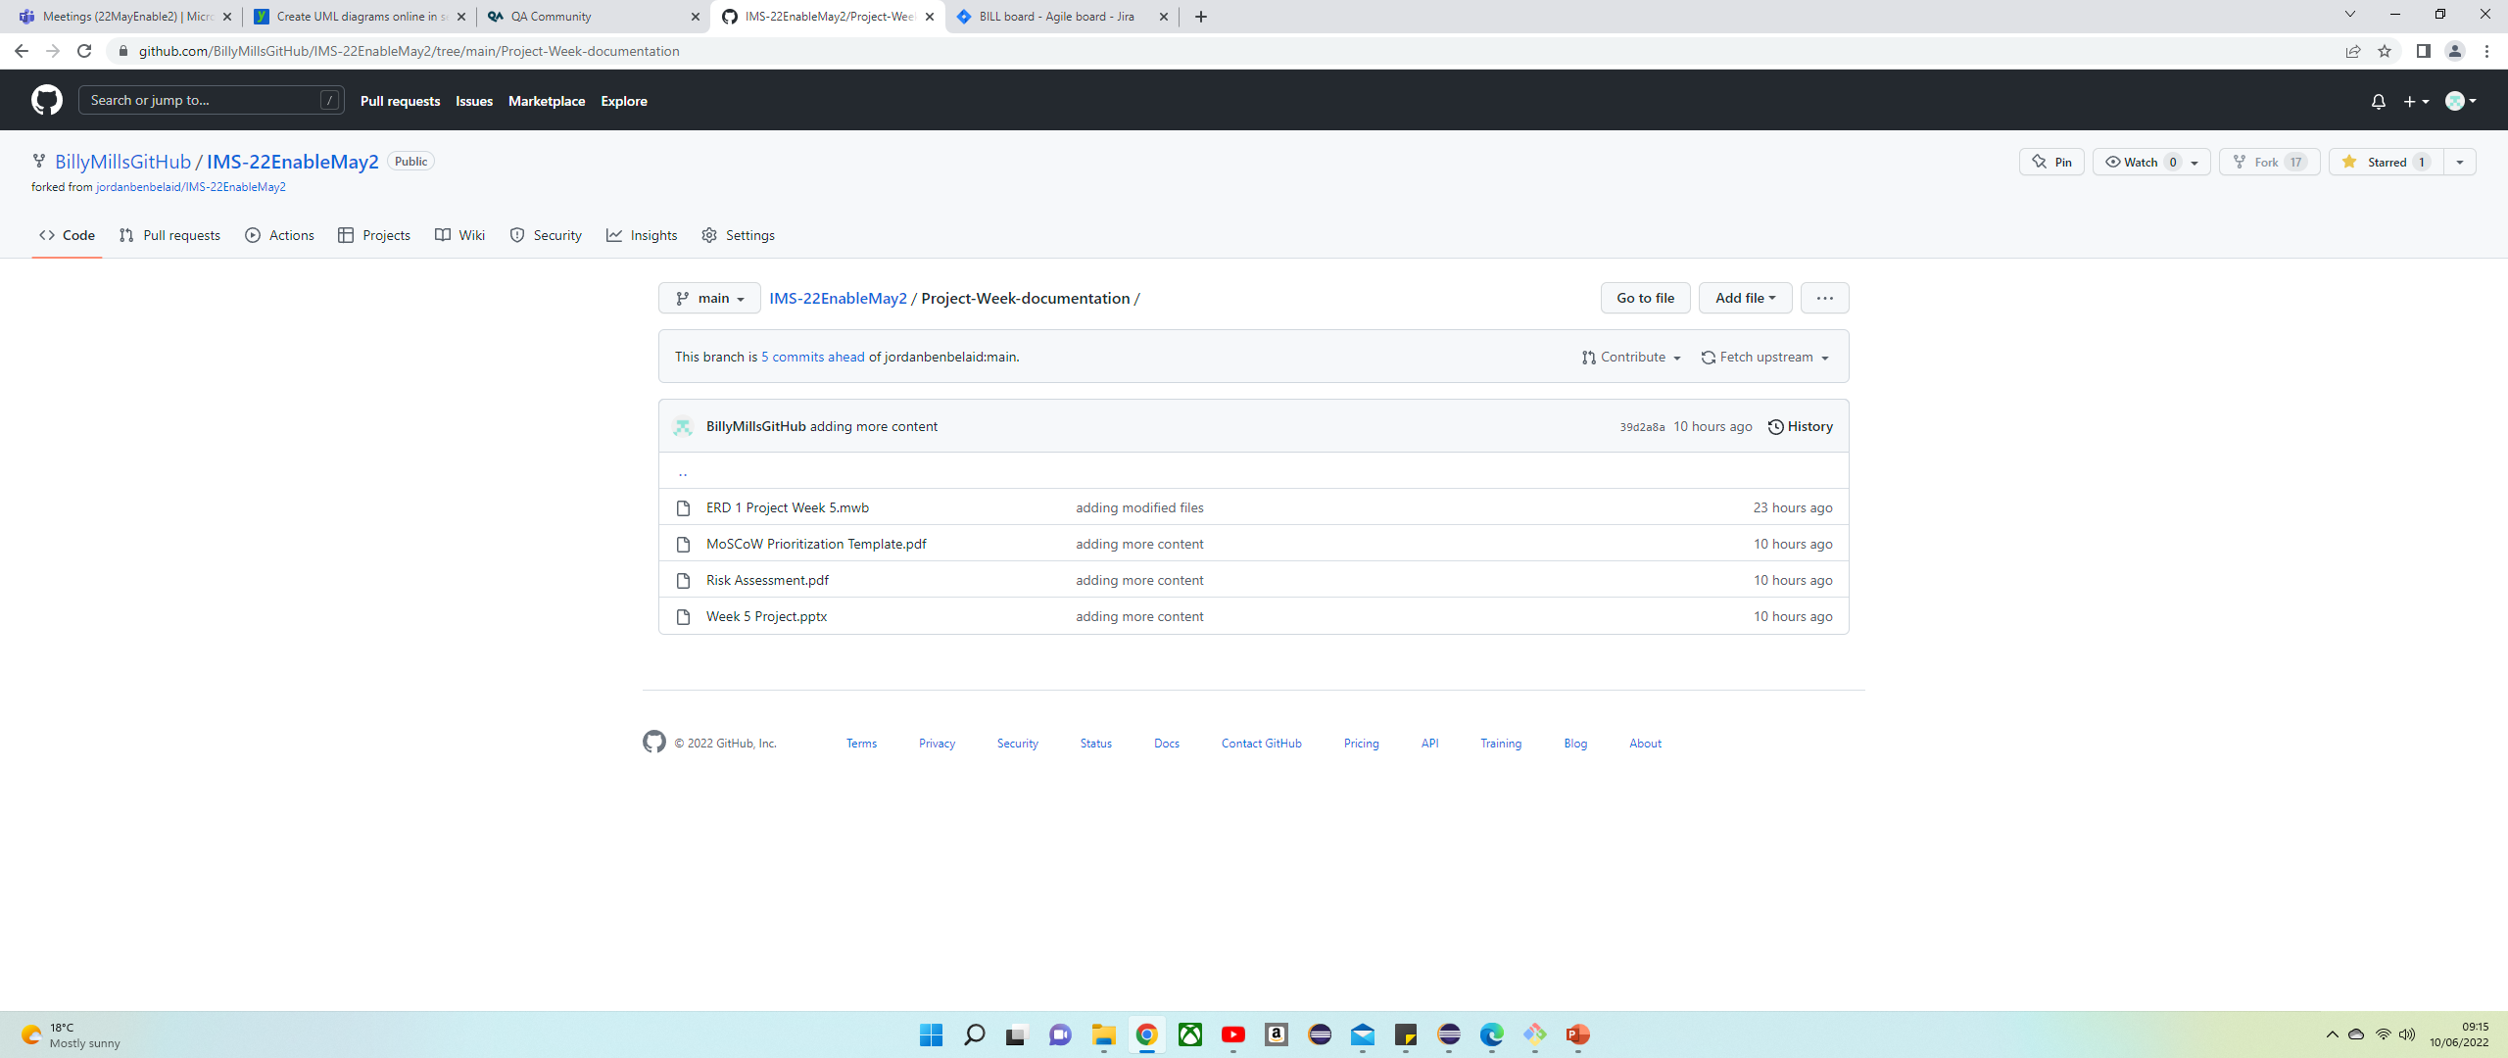
Using GitHub to store all documentation in a repository

Slide 18
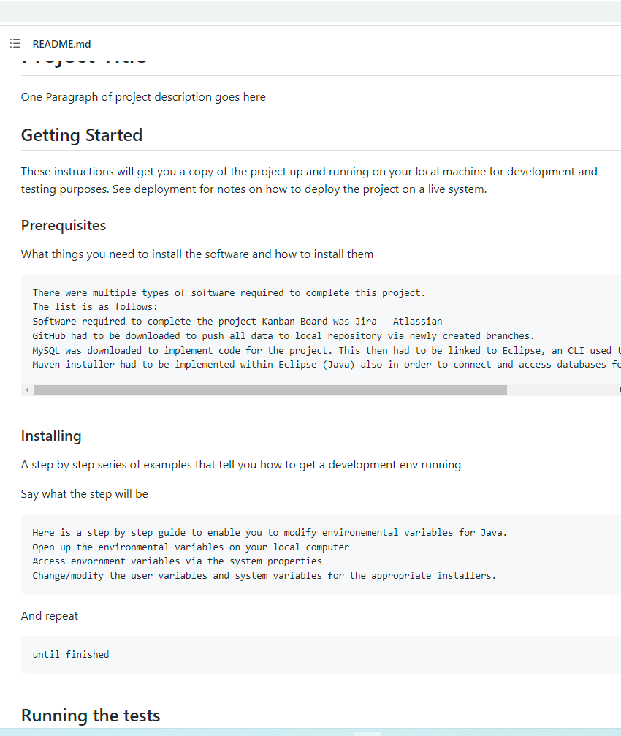
Updating the README.md document

Slide 19
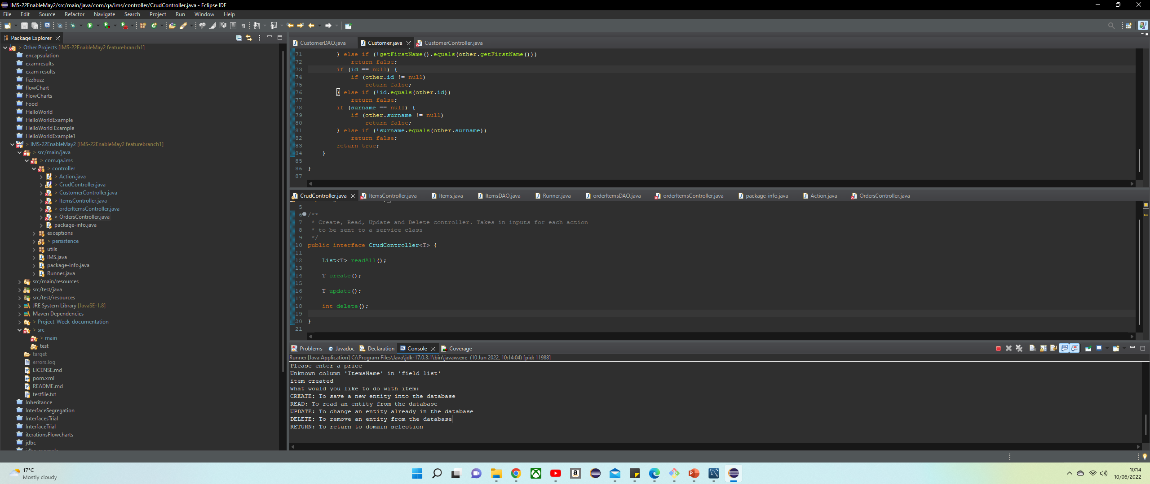
Fixing errors in code before testing

Slide 20
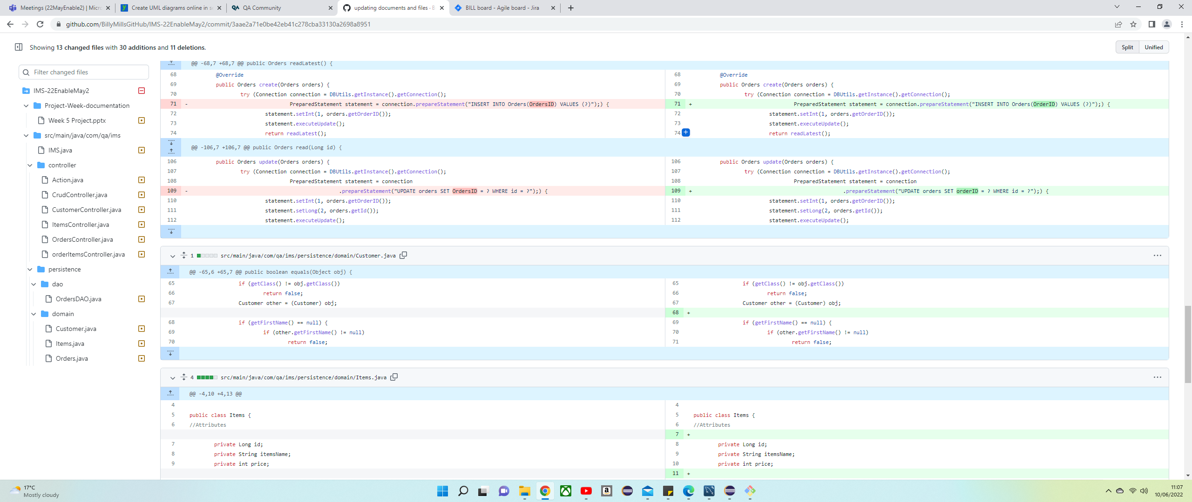
Highlighting errors found to resolve and pushing to repository for record of progress

Slide 21
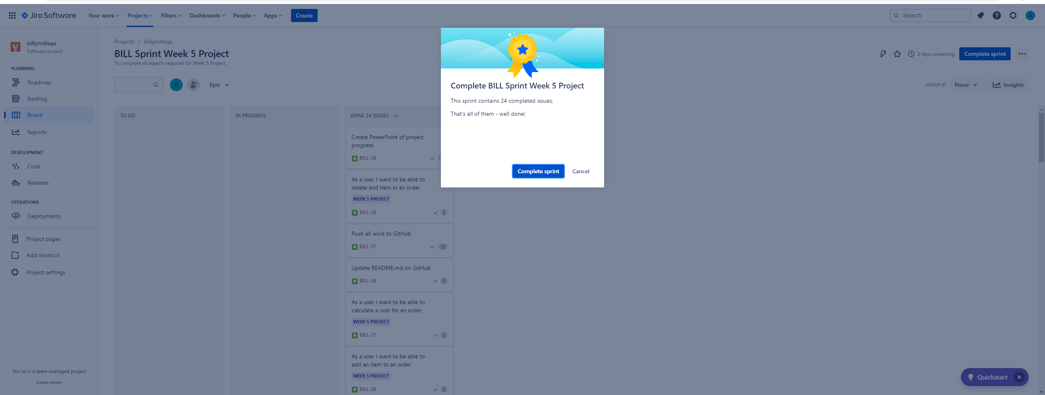

Slide 22
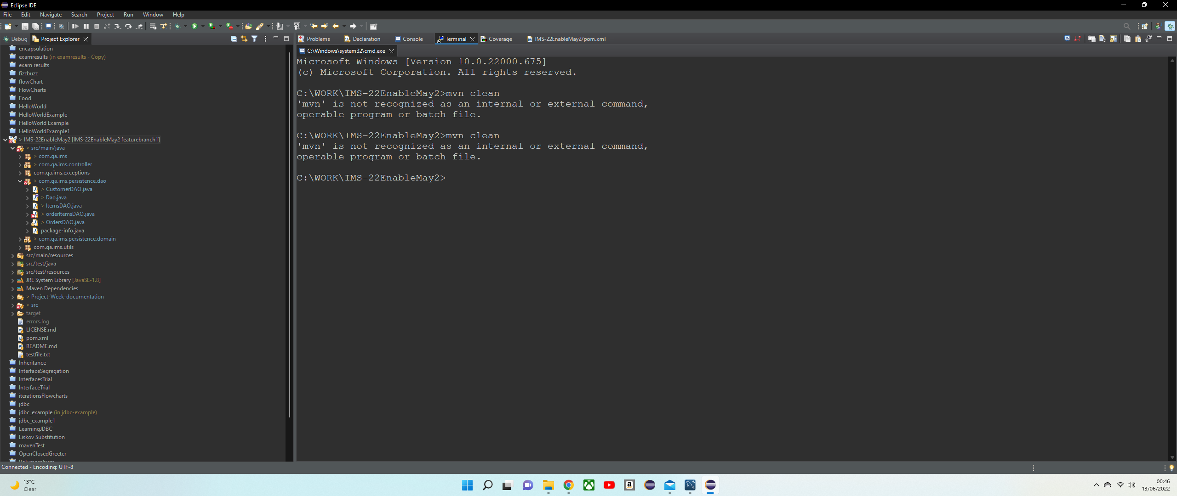
Could not install fatjar due to issue with maven.

